Slide 1
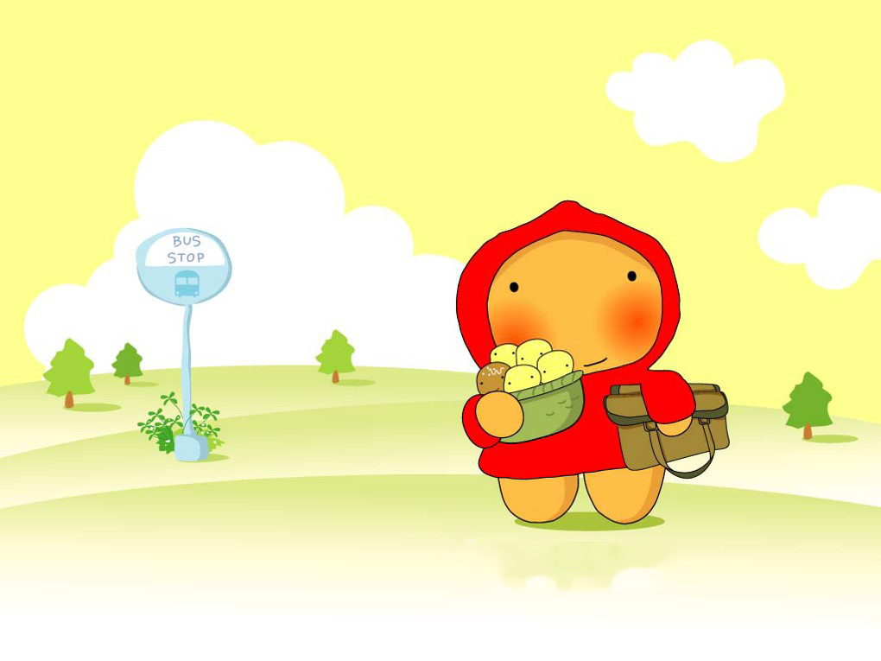
Unit 3 We all like PE!

Slide 2
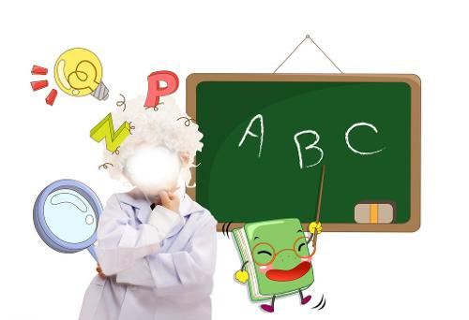
See and learn
English

Slide 3

See and learn
computer class

Slide 4
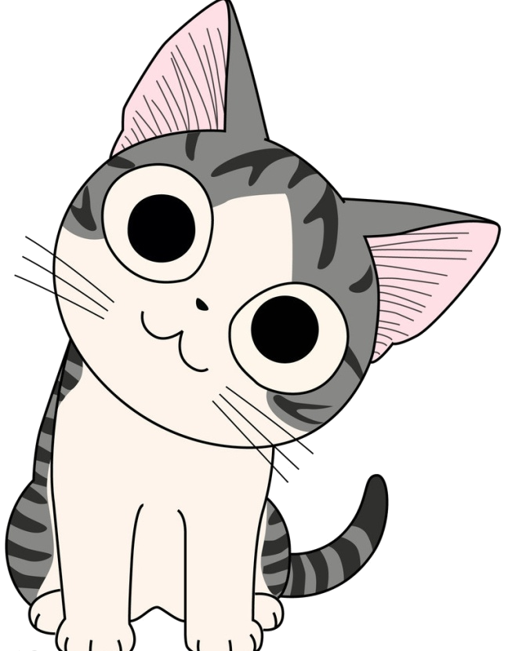
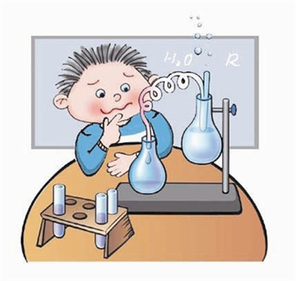
See and learn
science

Slide 5
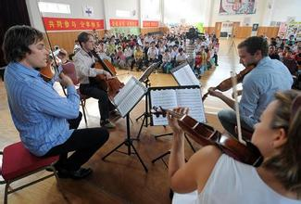
See and learn
music

Slide 6
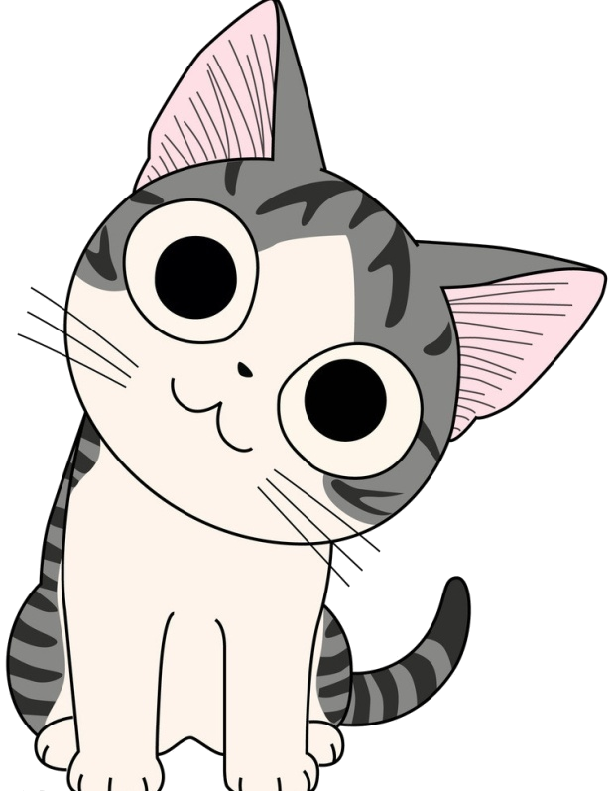
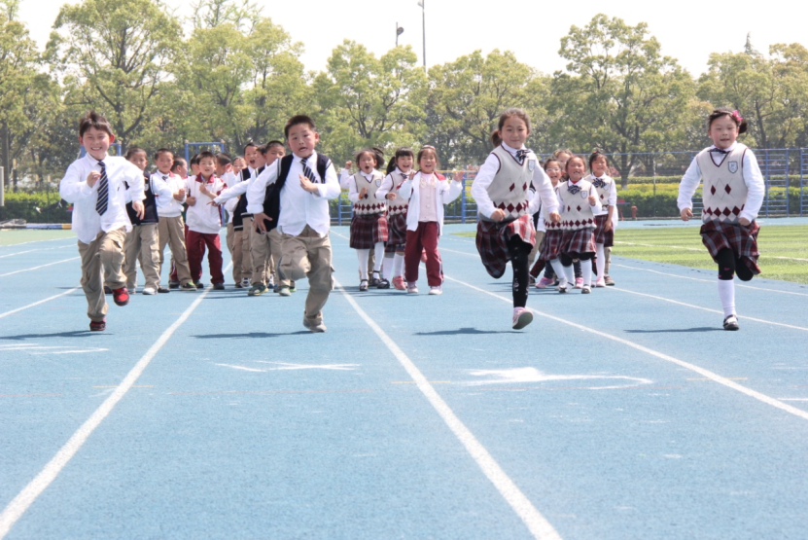
See and learn
PE

Slide 7
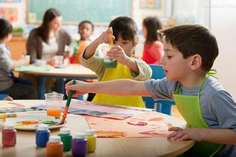
See and learn
art

Slide 8
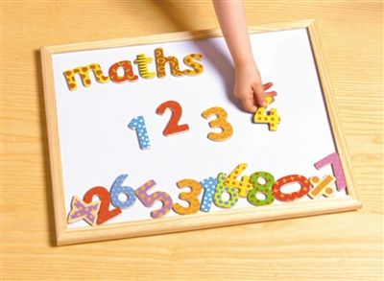
See and learn
maths

Slide 9
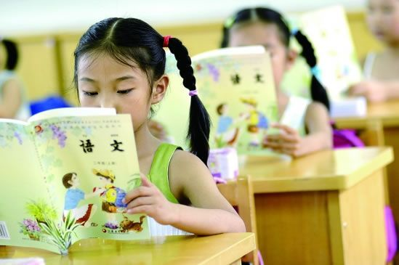
See and learn
Chinese

Slide 10
Fill in the schedule of your classes today.
Today
Time | Subjects | Time | Subjects

Slide 11
Thank you!

